Slide 1
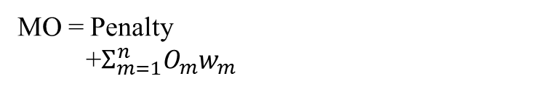
Boundary condition
and constraints
DE generate geometric input
Design evaluation using FEA
MO = Penalty
+$Σ_{m=1}^{n}O_{m}w_{m}$
Mutation, Crossover

Slide 2
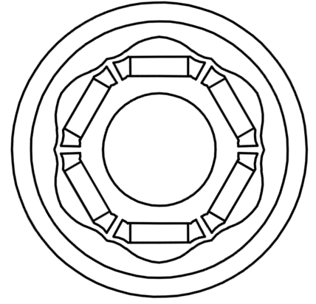














$$Φ D_{ring}$$
$$ΦD_{Arc1}$$
$$ring_{th}$$
$$R_{Arc1}$$
$$R_{Arc2}$$
$ΦD_{Arc2}$
$$m_{in1}$$
$$Φ D_{Hall}$$
$$m_{gap}$$
$$b_{th2}$$
$$m_{th}$$
$$SW$$
$$b_{th1}$$
$$ΦD_{in}$$

Slide 3
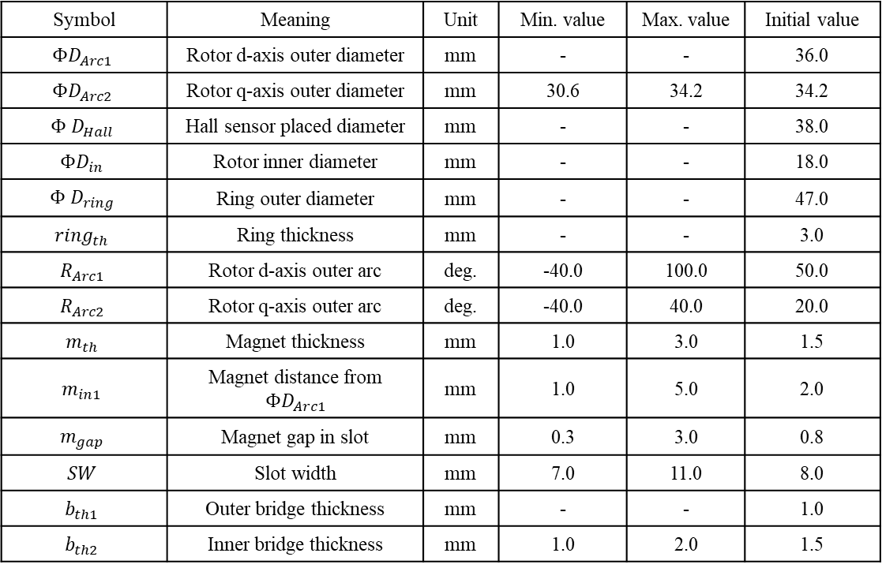
Symbol | Meaning | Unit | Min. value | Max. value | Initial value
$$ΦD_{Arc1}$$ | Rotor d-axis outer diameter | mm | - | - | 36.0
$$ΦD_{Arc2}$$ | Rotor q-axis outer diameter | mm | 30.6 | 34.2 | 34.2
$$Φ D_{Hall}$$ | Hall sensor placed diameter | mm | - | - | 38.0
$$ΦD_{in}$$ | Rotor inner diameter | mm | - | - | 18.0
$$Φ D_{ring}$$ | Ring outer diameter | mm | - | - | 47.0
$$ring_{th}$$ | Ring thickness | mm | - | - | 3.0
$$R_{Arc1}$$ | Rotor d-axis outer arc | deg. | -40.0 | 100.0 | 50.0
$$R_{Arc2}$$ | Rotor q-axis outer arc | deg. | -40.0 | 40.0 | 20.0
$$m_{th}$$ | Magnet thickness | mm | 1.0 | 3.0 | 1.5
$$m_{in1}$$ | Magnet distance from $ΦD_{Arc1}$ | mm | 1.0 | 5.0 | 2.0
$$m_{gap}$$ | Magnet gap in slot | mm | 0.3 | 3.0 | 0.8
$$SW$$ | Slot width | mm | 7.0 | 11.0 | 8.0
$$b_{th1}$$ | Outer bridge thickness | mm | - | - | 1.0
$$b_{th2}$$ | Inner bridge thickness | mm | 1.0 | 2.0 | 1.5

Slide 4
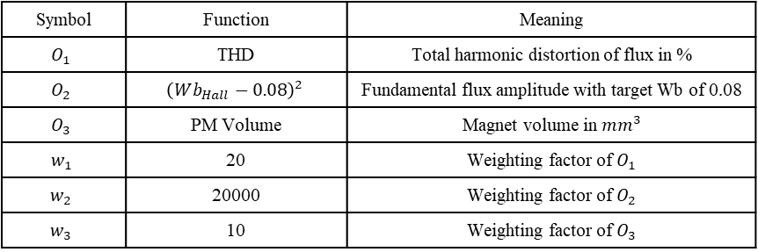
Symbol | Function | Meaning
$$O_{1}$$ | THD | Total harmonic distortion of flux in %
$$O_{2}$$ | $${\left(Wb_{Hall}−0.08\right)}^{2}$$ | Fundamental flux amplitude with target Wb of 0.08
$$O_{3}$$ | PM Volume | Magnet volume in ${mm}^{3}$
$$w_{1}$$ | 20 | Weighting factor of $O_{1}$
$$w_{2}$$ | 20000 | Weighting factor of $O_{2}$
$$w_{3}$$ | 10 | Weighting factor of $O_{3}$

Slide 5
Proposed objective function for the fundamental amplitude
Using a simple quadratic equation aiming for a value,
$$cost=gain∗{\left(output−aimed output\right)}^{2}$$
Aimed output = 5
Aimed output = 0.08 T
Lower output
Higher
output
Aimed
output
To aim for 0.08T, gain of 5000 will be used
$$\text{Cost}\text{(}\text{objective}\text{ 3})=5000∗{\left(Amp_fundamental[T]−0.08\right)}^{2}$$

